Slide 1
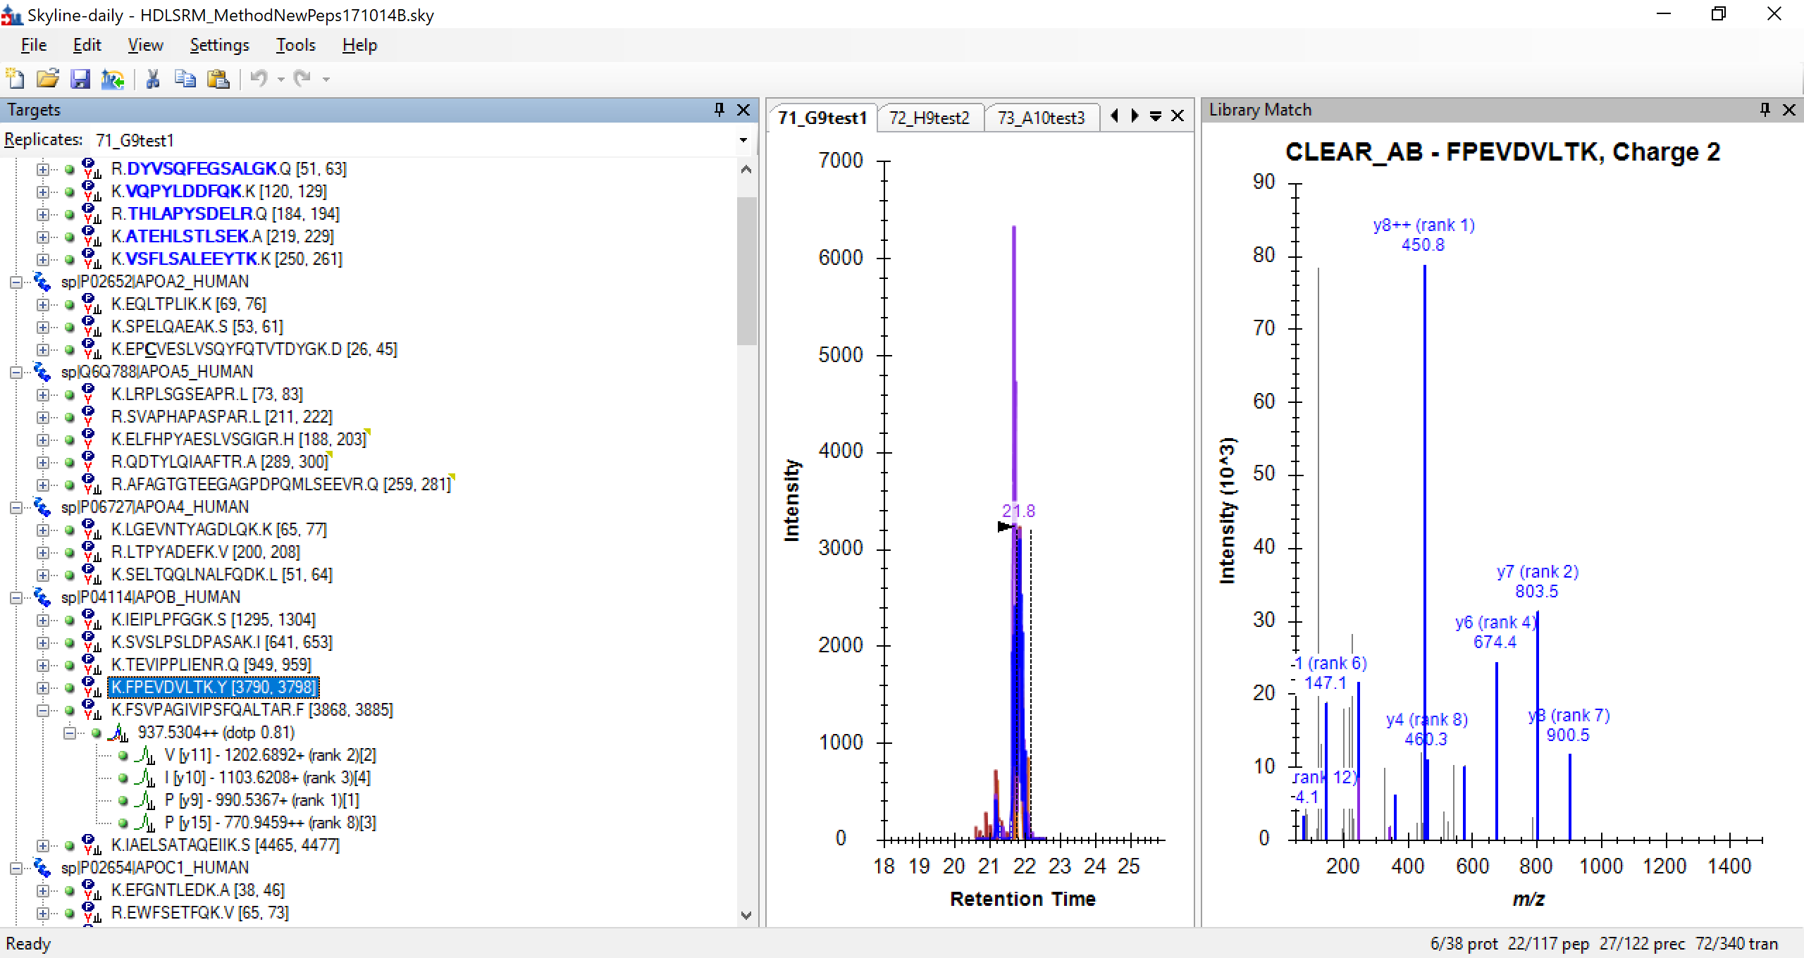
From this the clib was created (by uploading into Panorama)

Slide 2
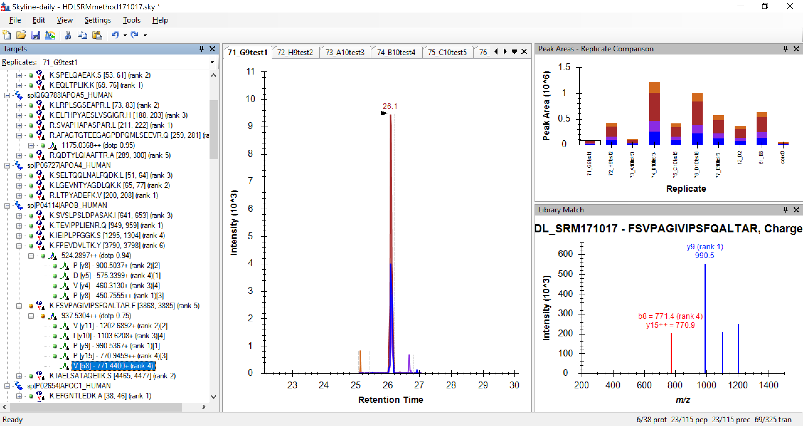
After .clib upload – a b8 ion forced into the transitions even though it was not in the uploaded transitions

