Slide 1
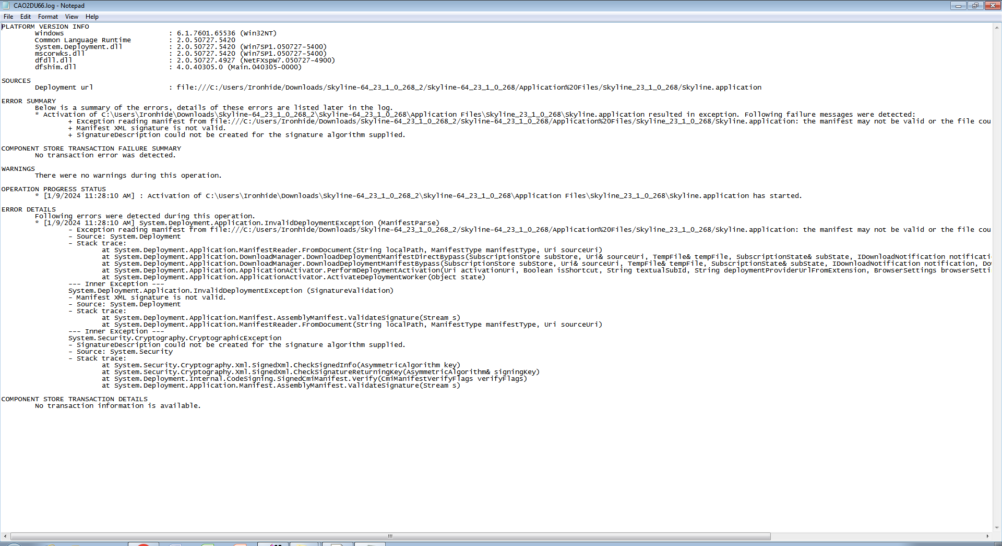
Skyline Downloading Error Details

Slide 2
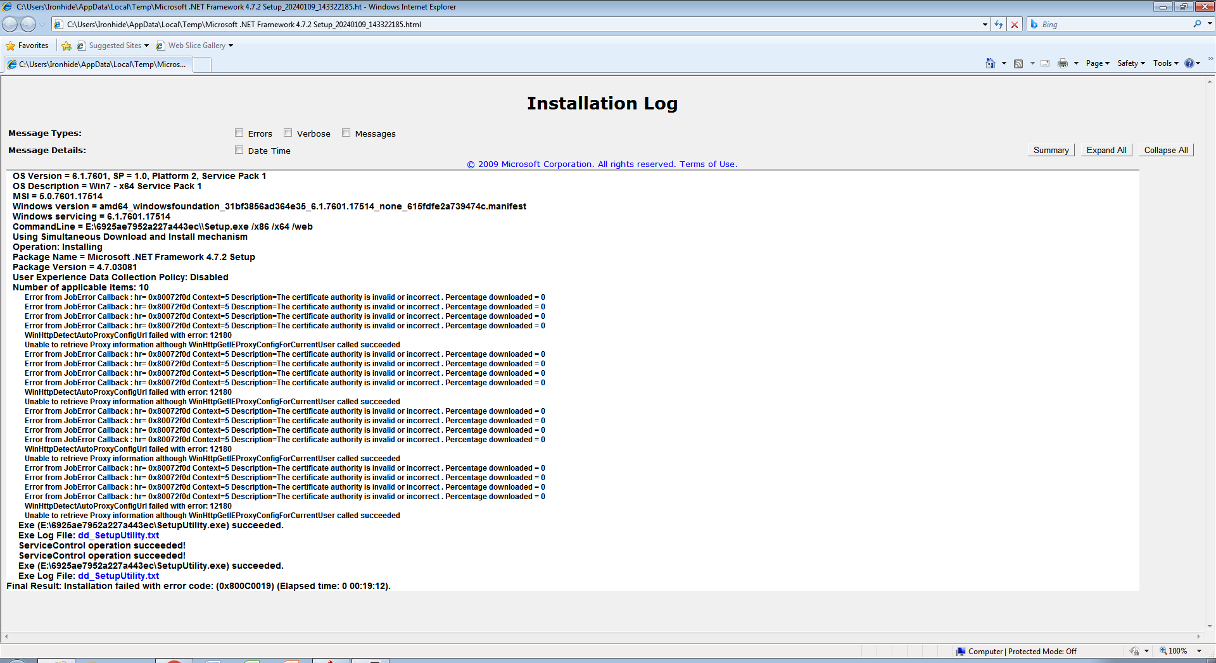
.NET Framework 4.0 Downloading Error Details

Slide 3
