Slide 1
Annotation for longitudinal SSS (System Suitability Samples)
https://panoramaweb.org/labkey/project/Schilling/QC_Collaboration_Vitek/longitudinal%20SSS/begin.view?
acquisition of System Suitability Samples (SSS) over course of 1 week on Triple Quadrupole Instruments.
SSS were interspersed into biomarker plasma assessment study samples throughout the week (Abbatiello et al., MCP 2015), study total runs ~ 300 acquistions
6 sites selected to show SSS performance (QC), monitoring digested 6 protein mix (15 peptides) as part of the larger study: sites 86, 54, 65, 56C, 56A, 90
Comments and notes about uploaded files (also see slides attached):
86: Site86_Study9.1_SSS_QCED, quite nice and robust SSS performance throughout the study, basically for all monitored peptides
54: Site54_Study9-1_SSS_111611_QCED, quite nice SSS, very nice and robust for majority of peptides, One ‘empty’ run called SSS_run_109, also Slight ‘random’ problems with 2 hydrophobic, late eluting peptides VGP and also FFV (note a 3 letter code is used for any of the 15 monitored peptides, first 3 amino acids)
65: Study9.1 Site65 SSS runs_QCED, quite nice SSS, some slight variation that for the study heavy peptide spikes could account for.
56C: Study9_1_Site56C_SSS_Final_101711_QCED, quite nice SSS, Some of the SSS runs in the beginning have signal loss on some late eluting peptides (VGP, FFV), Most other peptides are fine, even for problem peptides things stabilized after several runs in the beginning, and the study could be performed fine.
56A: Study9p1_site_56A_5500_SSS_runs_final_QCED, overall ok. some sensitivity loss observed over the study, notes from operator :
Changed the chip in pos 1 before the run # 155
Cleaned the Mass Spec before the run # 255.; sensitivity jumped up nicely after cleaning to anticipated performance.
90: Study9S_Site90_SSS_QCED, SSS is borderline as signal goes up and down .... heavy peptides in study can account for a lot, but LOD/LOQ suffered a little bit

Slide 2
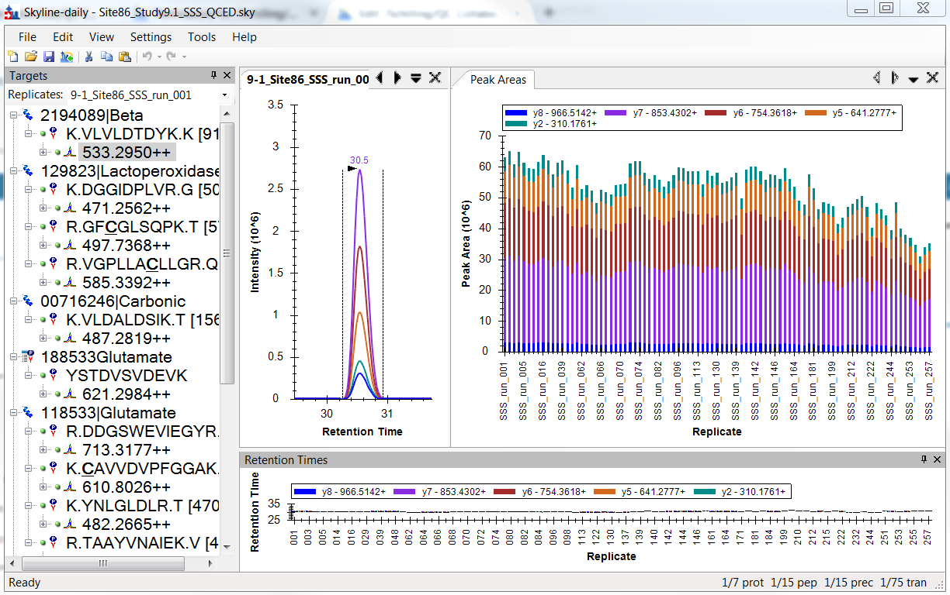
Site 86, file Site86_Study9.1_SSS_QCED
Very good
Peptide VLV at 533.29

Slide 3
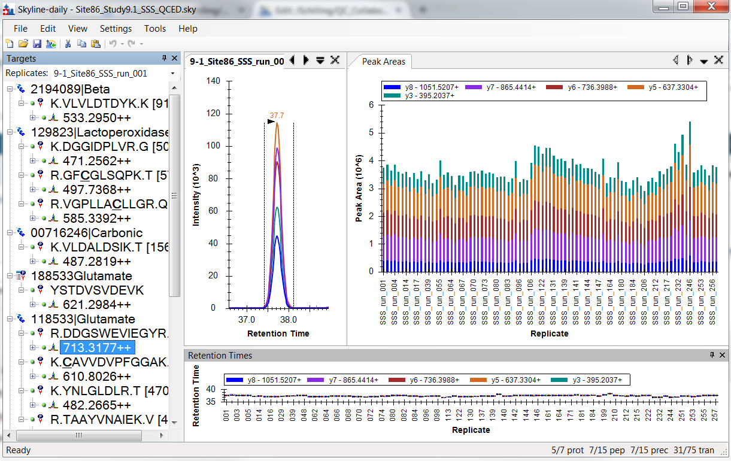
Site 86, file Site86_Study9.1_SSS_QCED
Very good
Peptide DDG at 713.32

Slide 4
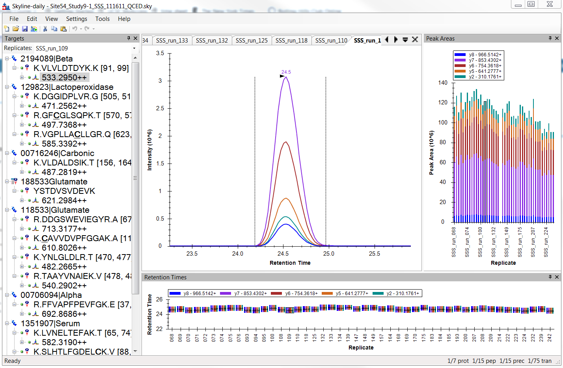
Site 54, file : Site54_Study9-1_SSS_111611_QCED
One ‘empty’ run
Called SSS_run_109
Very nice
Peptide VLV at 533.29

Slide 5
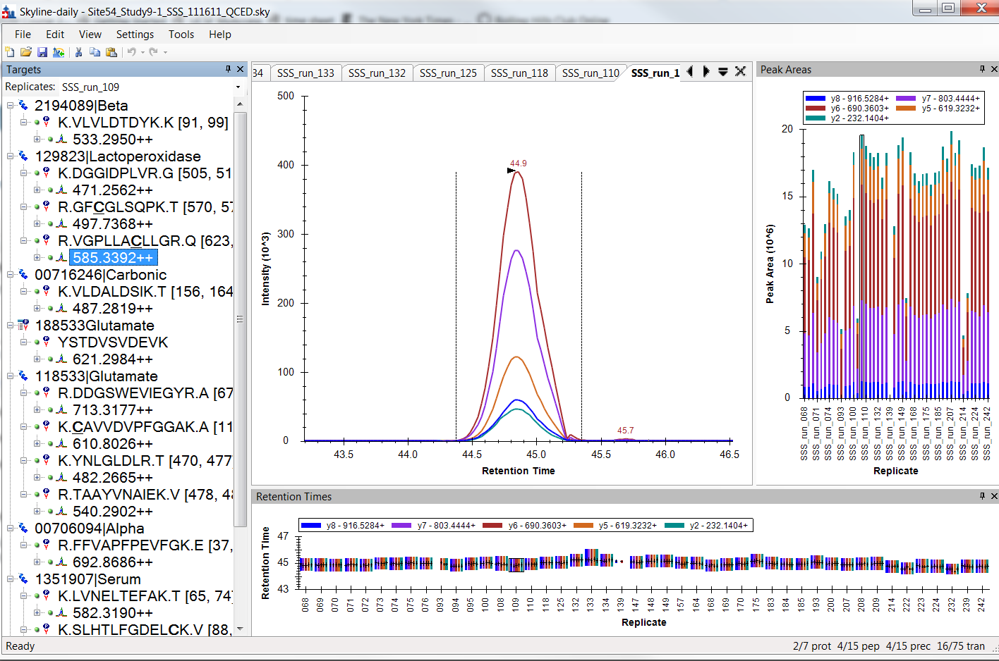
Site 54, file : Site54_Study9-1_SSS_111611_QCED
Slight ‘random’ problems with 2 hydrophobic, late eluting peptides VGP and also FFVA
Peptide VGP at 585.34

Slide 6
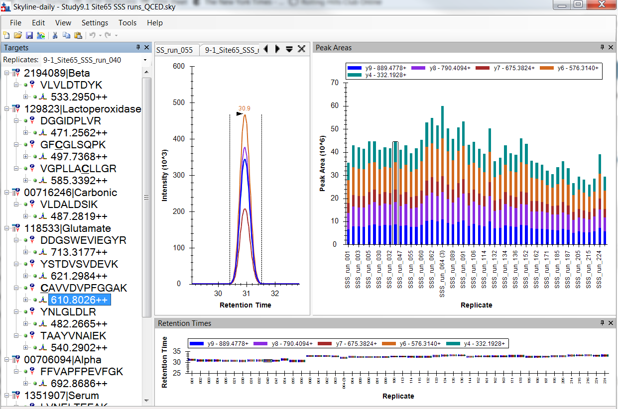
Site 65: Study9.1 Site65 SSS runs_QCED
Quite nice SSS
Peptide CAV at 610.80

Slide 7
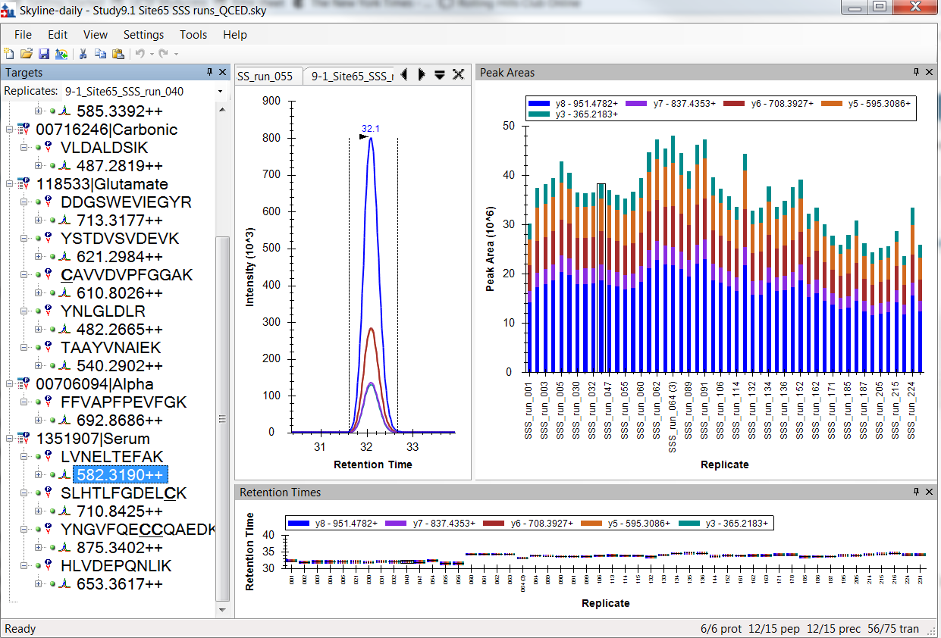
Site 65: Study9.1 Site65 SSS runs_QCED
Quite nice SSS
Peptide LVN at 582.32

Slide 8
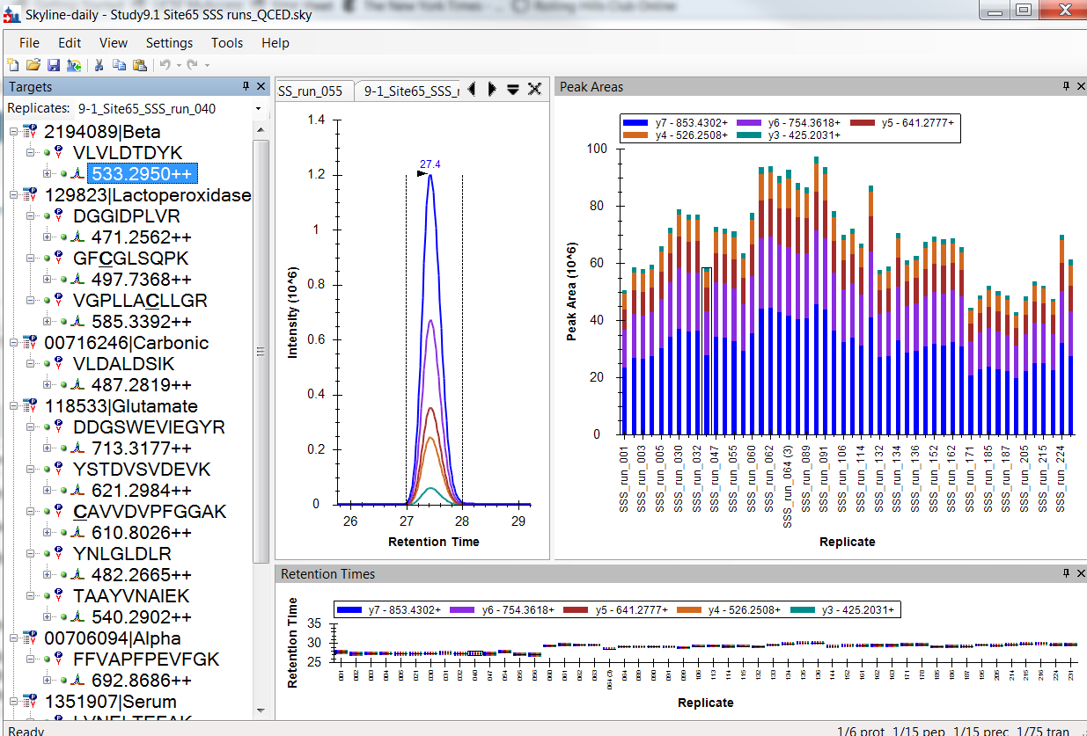
Site 65: Study9.1 Site65 SSS runs_QCED
Quite nice SSS, slight variation observed, heavy peptides spiked into real study can account for that
Peptide VLV at 533.30

Slide 9
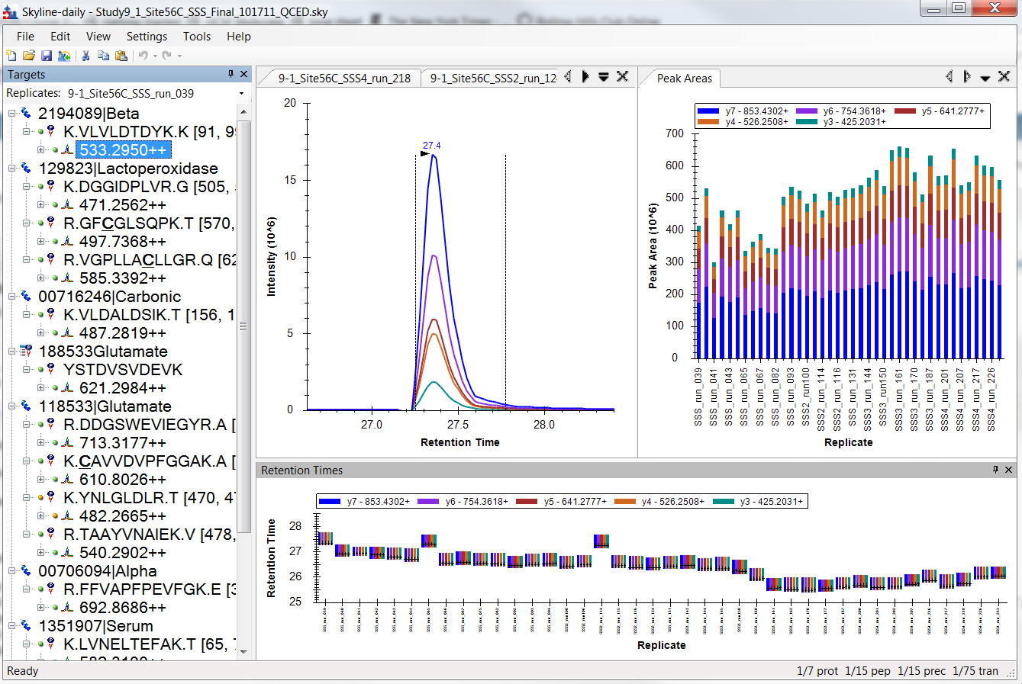
Site 56C: Study9_1_Site56C_SSS_Final_101711_QCED
Peptide VLV at 533.30
Fairly nice SSS

Slide 10
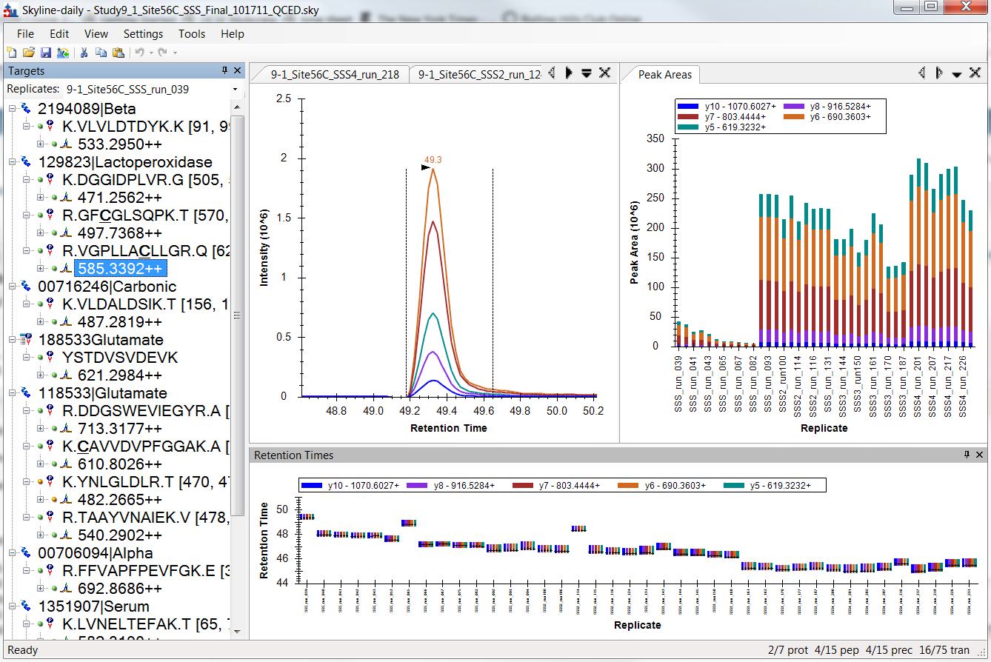
Site 56C: Study9_1_Site56C_SSS_Final_101711_QCED
Some of the SSS runs in the beginning have signal loss on some late eluting peptides (VGP, FFV)
Peptide VGP at 585.34

Slide 11
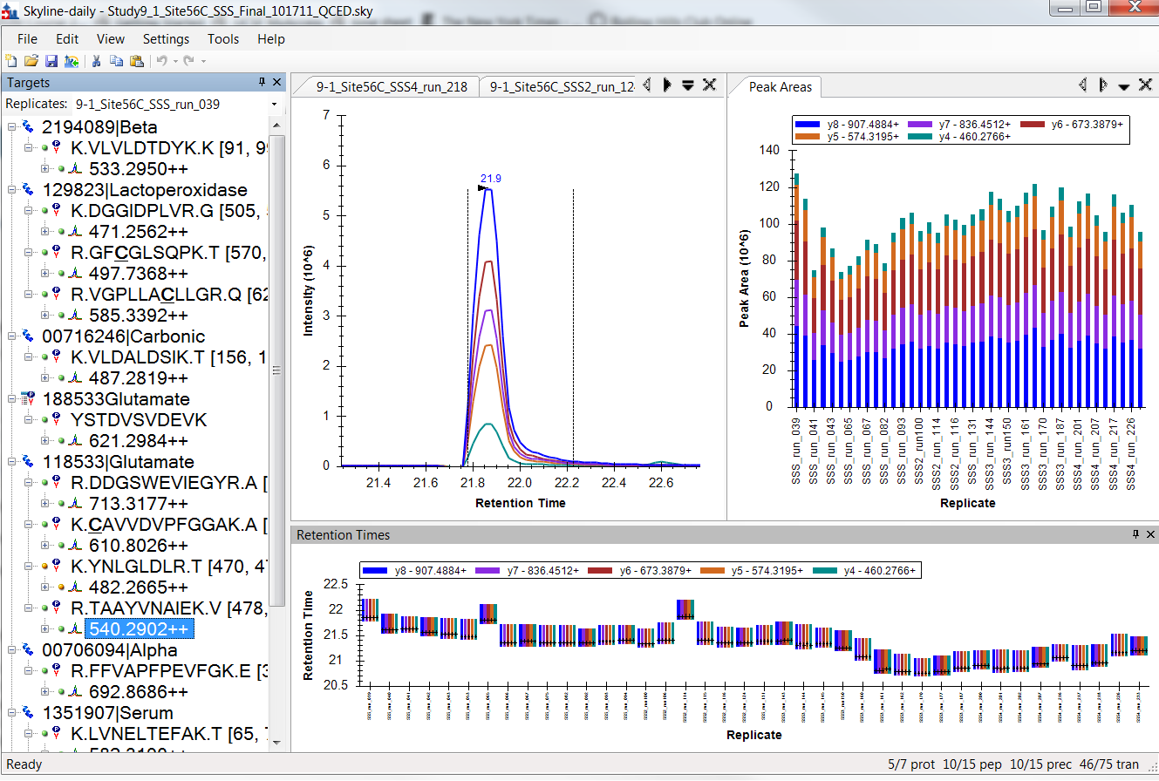
Site 56C: Study9_1_Site56C_SSS_Final_101711_QCED
Most peptides fine, even for problem peptides things stabilized after several runs
Peptide TAA at 540.29

Slide 12
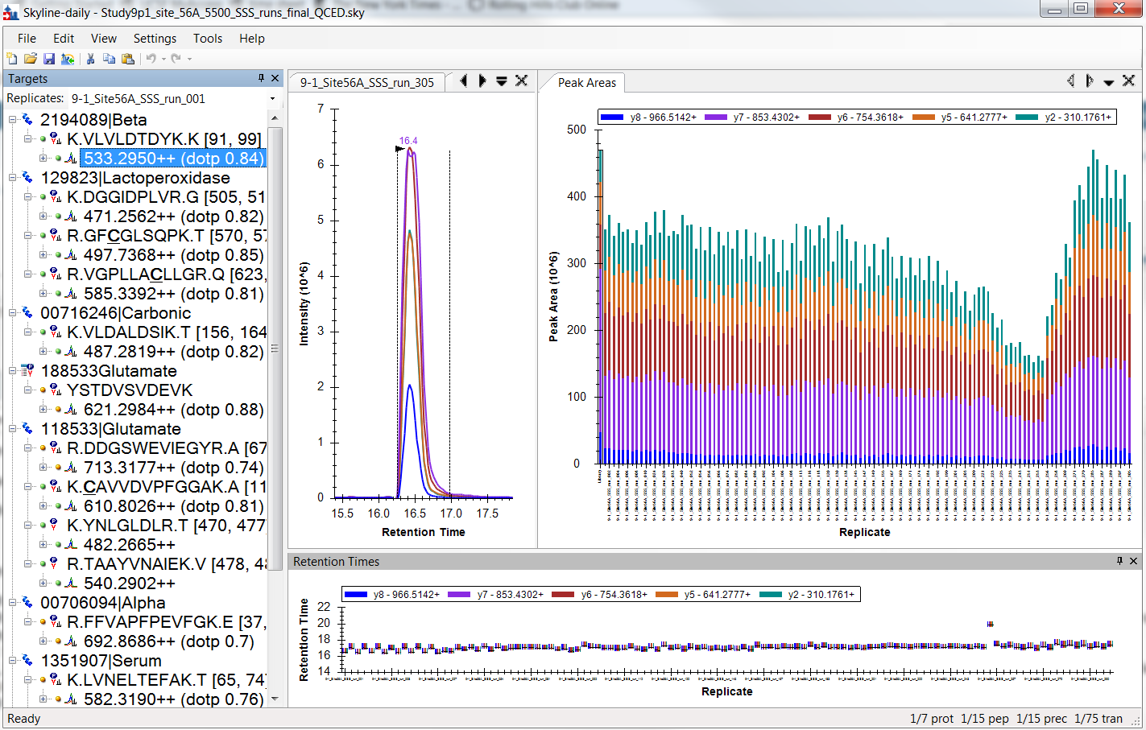
Instrument MS cleaning
Site 56A: Study9p1_site_56A_5500_SSS_runs_final_QCED
Peptide VLV at 533.30

Slide 13
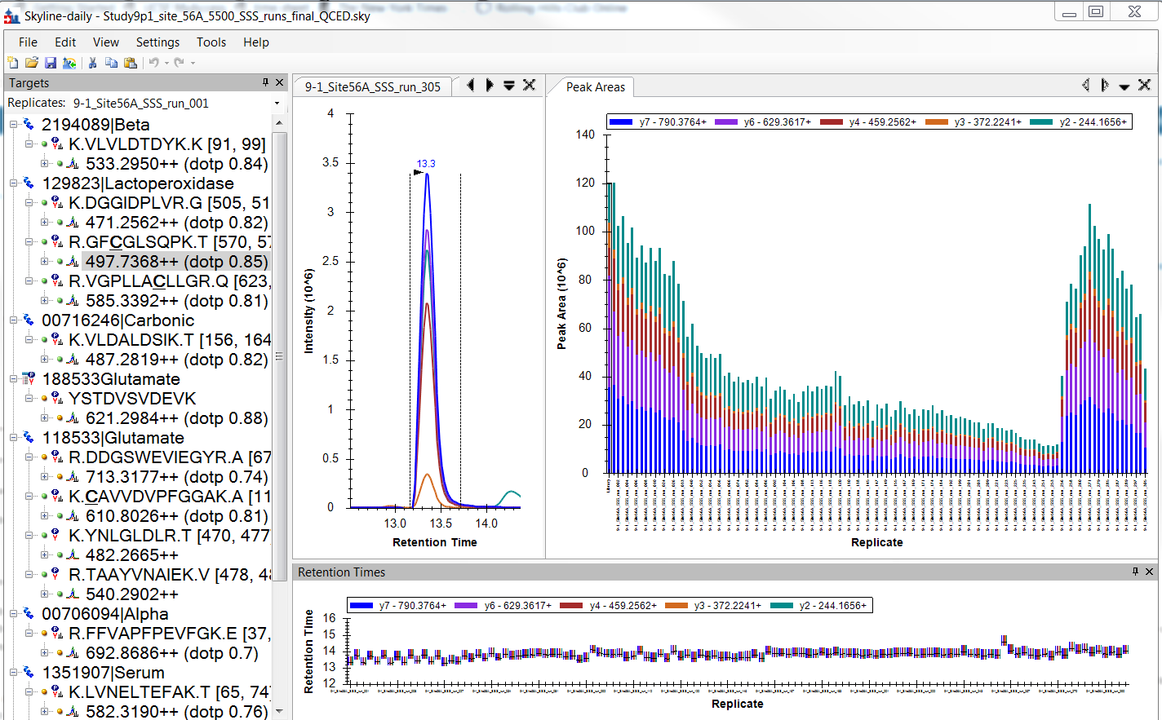
Instrument MS cleaning
Site 56A: Study9p1_site_56A_5500_SSS_runs_final_QCED
Peptide GFCat 497.74

